Slide 1
Topics in CS1- DRL for Testing a Game
By: Teni, Jerico Robles (1008776635), Jugal Patel (100744586), Nadman Khan (100785940)

Slide 2
Overview:
Introduce the game we tested using the LLM (The Binding Isaac & Snake)
Running each commands for each file
How to Run quick_train.py and what it does?
How to Run train.py and what it does
How to run watch.py and what it does

Slide 3
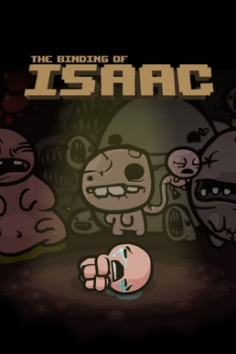
Introducing the Game and the Topic:
Game chosen to test on the LLM is The Binding of Isaac.
Is a survival game
Isaac has to escape from his mom who is religious and is attempting to sacrifice him.
The LLM will run tests on the following python files:
quick_train.py
train.py
watch.py
eval.py

Slide 4
quick_train.py
Purpose:
will test run multiple files and generate models for each files quickly
How it’s tested:
checks for reproductivity,
ensures models are saved to logs/pp_<persona> correctly.

Slide 5
Train.py
Purpose:
is configurable in training the scripts which is seeded, and is persona-based by algorithm swap.
How is it tested?
Runs parameterized training jobs such as:
PPO
A2C
Ensures that the arguments are parsed
Uses TensorBoard logging, and metric saving work.

Slide 6
Watch.py
Purpose:
Is to playback the mode for visualization and live interaction
How it’s Tested?
Ensures that the inference and rendering such as pygame work and the persona swapping loads the correct models

Slide 7
Eval.py
Purpose:
Is to create an quantitative evaluation of the saved models.
How it’s Tested?
It measures the episode of rewards and metrics that aggregates into the CSV summary for grading or comparison.

Slide 8
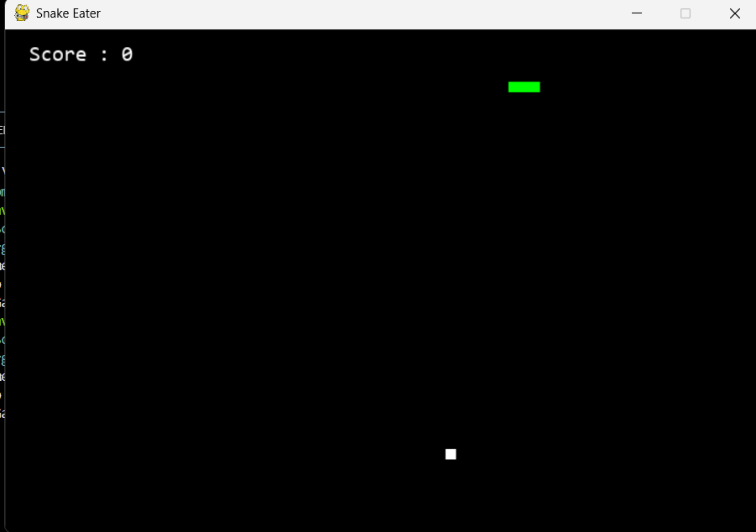

Second Game Test Snake Game DRL:
The second game is a simple classic Snake
The DRL Model is rewarded for
PPO and A2C Model
Two modes: “Length” and Survival
Length focuses on getting the Snake as long as possible
Survival focuses on maximizing time elapsed/steps

Slide 9
SnakeGame.py:
Originally created by Rajat Dipta Biswas
GitHub - rajatdiptabiswas/snake-pygame
Purpose:
Is a stand alone human playable Pygame Snake for baseline comparison.
How It’s Tested:
Confirms manual gameplay logic works (score, death, collisions, growth)

Slide 10
snake_env.py:
Purpose:
Has gym compatible RL environment wrapper.
Adapts the SnakeGame code into a DRL environment
Ensures basic functions such as:
Reset
Step
Render
Close
Helper functions for measuring Snake’s relative position to walls and food and visualizing the grid
And reward shaping functions.

Slide 11
train_PPO.py:
Purpose:
Is an PPO trainer for Snake.
Used for:
learning stability
Logging
and model saving.

Slide 12
eval.py:
Purpose:
Is the evaluation and metrics collector
The LLM would aggregate the episode results by:
Computing the stats
And saves the data to the JSON summary

Slide 13
visualize.py:
Replays the trained model visually
Somewhat painful watching the snake kill itself over and over

Slide 14
Reward Functions
survival_reward
Small reward for just existing
Death_penalty
Big penalty for dying
_food_eaten_reward
Big reward for eating food/growing
_any_turn_reward
_axis_direction_reward
Small reward/punish for moving in the correct direction to the food (rewards moving up/down and left/right in the right direction respectively)
_turning_to_food_reward
Bigger reward for turning in correct direction to food
_wall_evasion_reward
_distance_based_reward
Small reward /punish for proximity (capped positive/negative reinforcement)
_heading_toward_wall_punish
Broken but should punish for being close to a wall

